Slide 1




Jim's Activity Planner

Slide 2




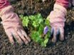






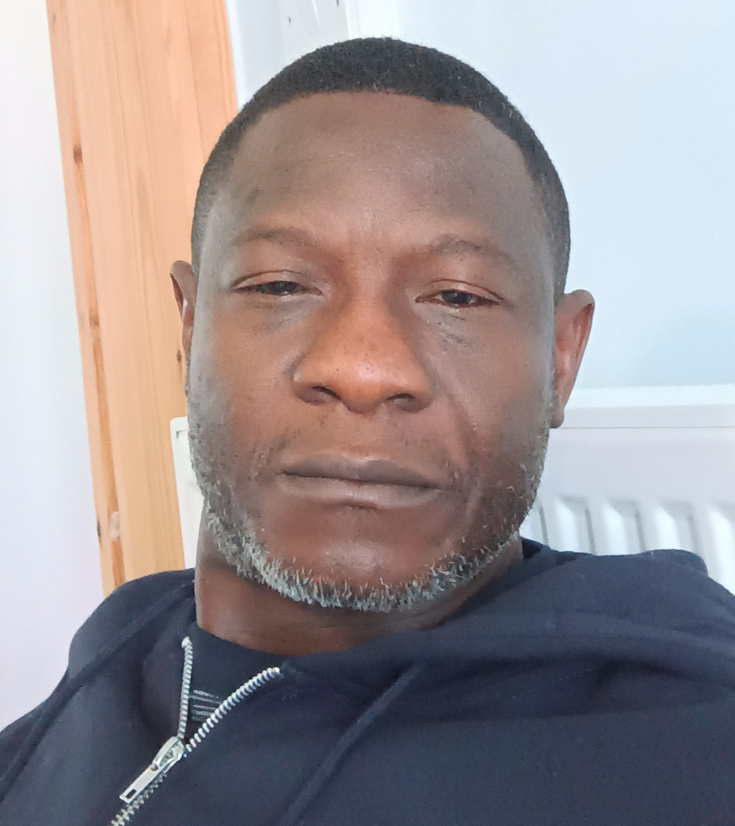



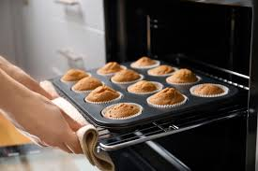
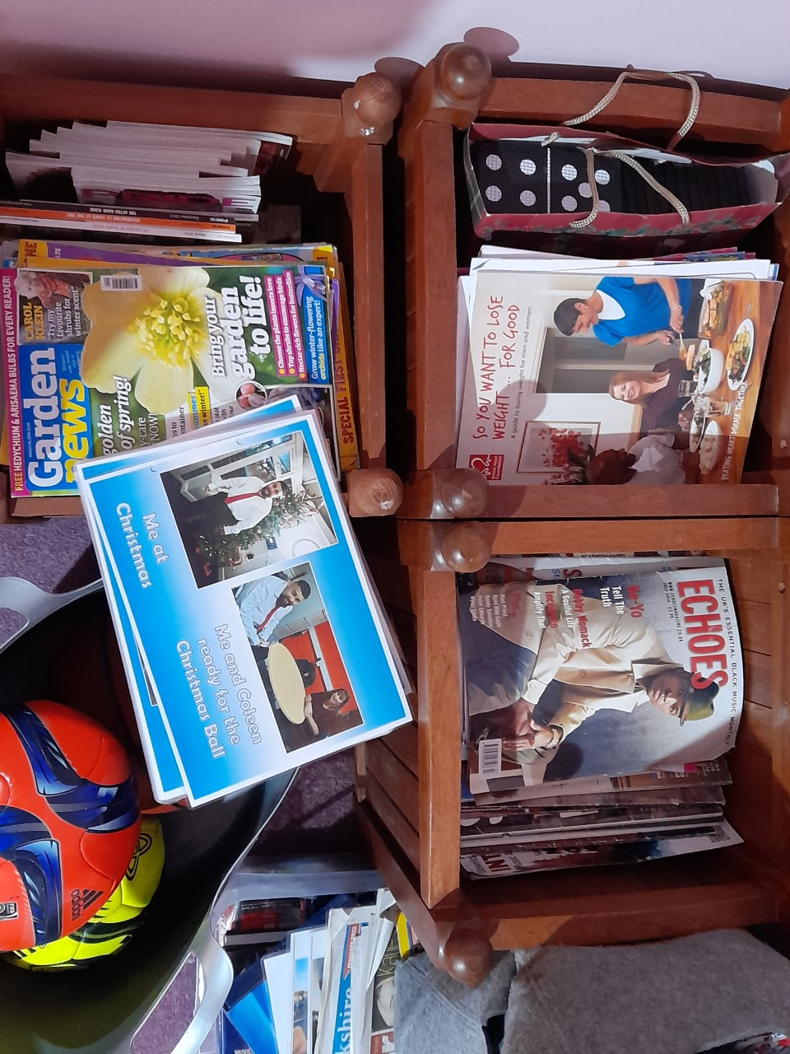
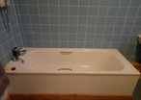


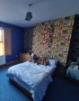
Monday 03/06/2024
Staff In!
Staff In!
Staff In!
Glen Tunji
Enock Tunji
Enock Jenifer
Enock
Activity! Activity! Activity!
Bath TV Guide Baking Photos, books, bedtime

Slide 3


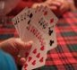

Tuesday 04/06/2024
Staff In!
Staff In!
Staff In!
Enock Glen
Glen Tunji
Tunji Jennifer
Tunji
Activity! Activity! Activity!
Bath iPad staff Collages & crafts Play cards supper and chat with staff

Slide 4
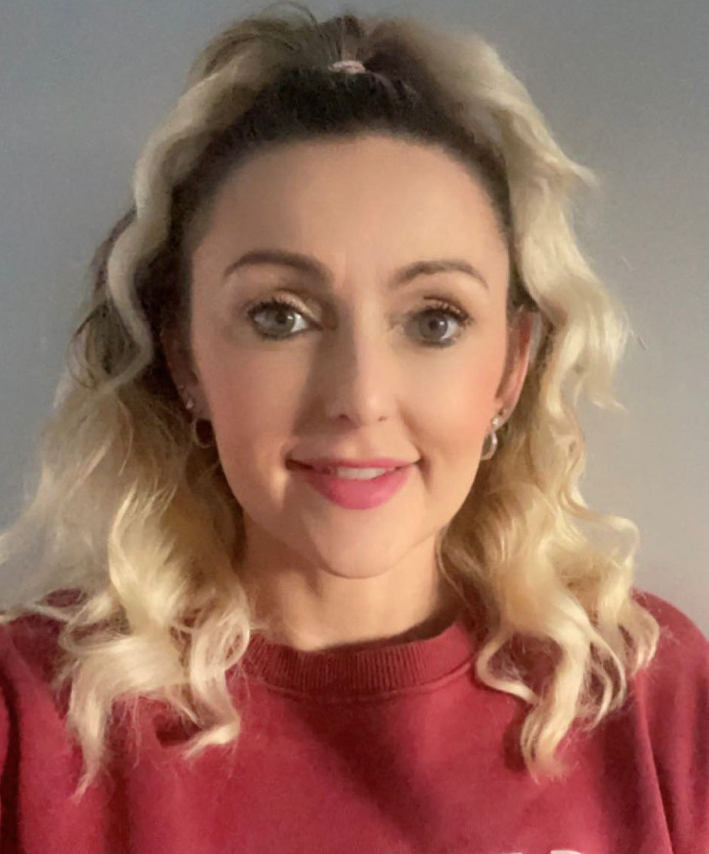
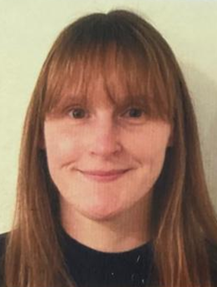



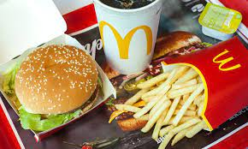

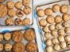


Wednesday 05/06/2024
Staff In!
Staff In!
Staff In!
Tunji Amin
Enock Amin
Enock Jacques
Enock
Activity! Activity! Activity!
Bath Drive Baking Newspaper Photo and Books & bed-time

Slide 5

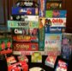
Thursday 06/06/2024
Staff In!
Staff In!
Staff In!
Enock Israel
Glen Jacques
Glen Jacques
Glen
Activity! Activity! Activity!
Bath Drive Posh meal Tea and chat

Slide 6

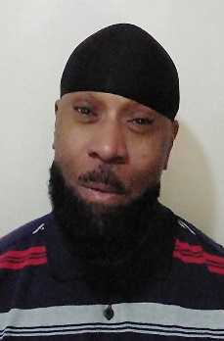

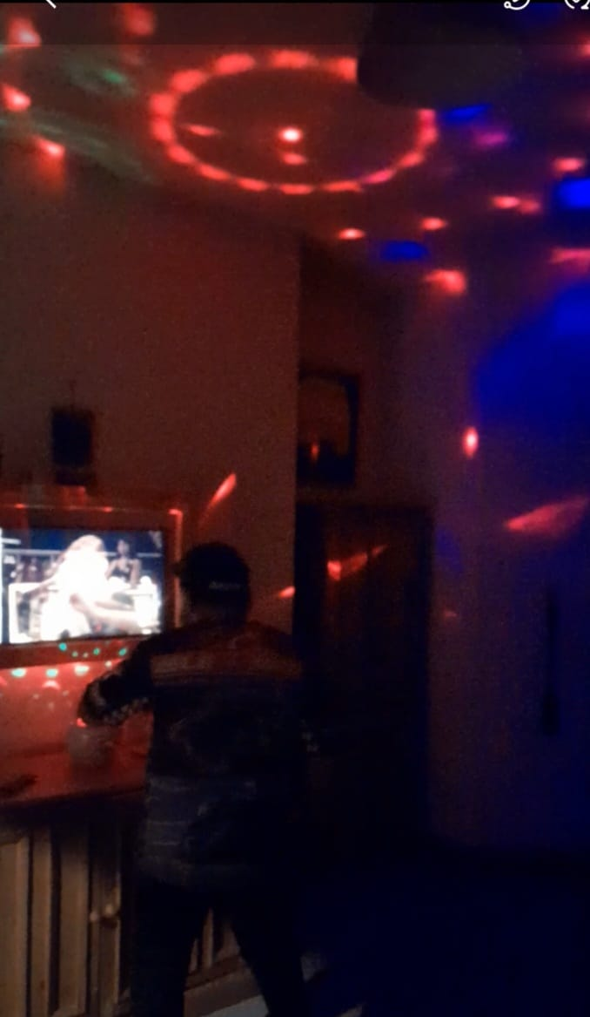

Friday 07/06/2024
Staff In!
Staff In!
Staff In!
Glen Enock
Enock Israel
Israel Jennifer
Israel
Activity! Activity! Activity!
Bath, Read newspaper iPad Karaoke & Quiz Disco and bed-time

Slide 7







Saturday 08/06/2024
Staff In!
Staff In!
Staff In!
Israel Alex
Tunji Alex
Tunji Andy
Tunji
Activity! Activity! Activity!
Bath cleaning Drive and Party night Supper and Dress to pyjama

Slide 8




Sunday 09/06/2024
Staff In!
Staff In!
Staff In!
Tunji Amin
Israel Amin
Israel Jacques
Israel
Activity! Activity! Activity!
Morning pyjamas Bath Drive Movie Night

